Slide 1
Route Combinations in 2020
Brandon Conner

Slide 2
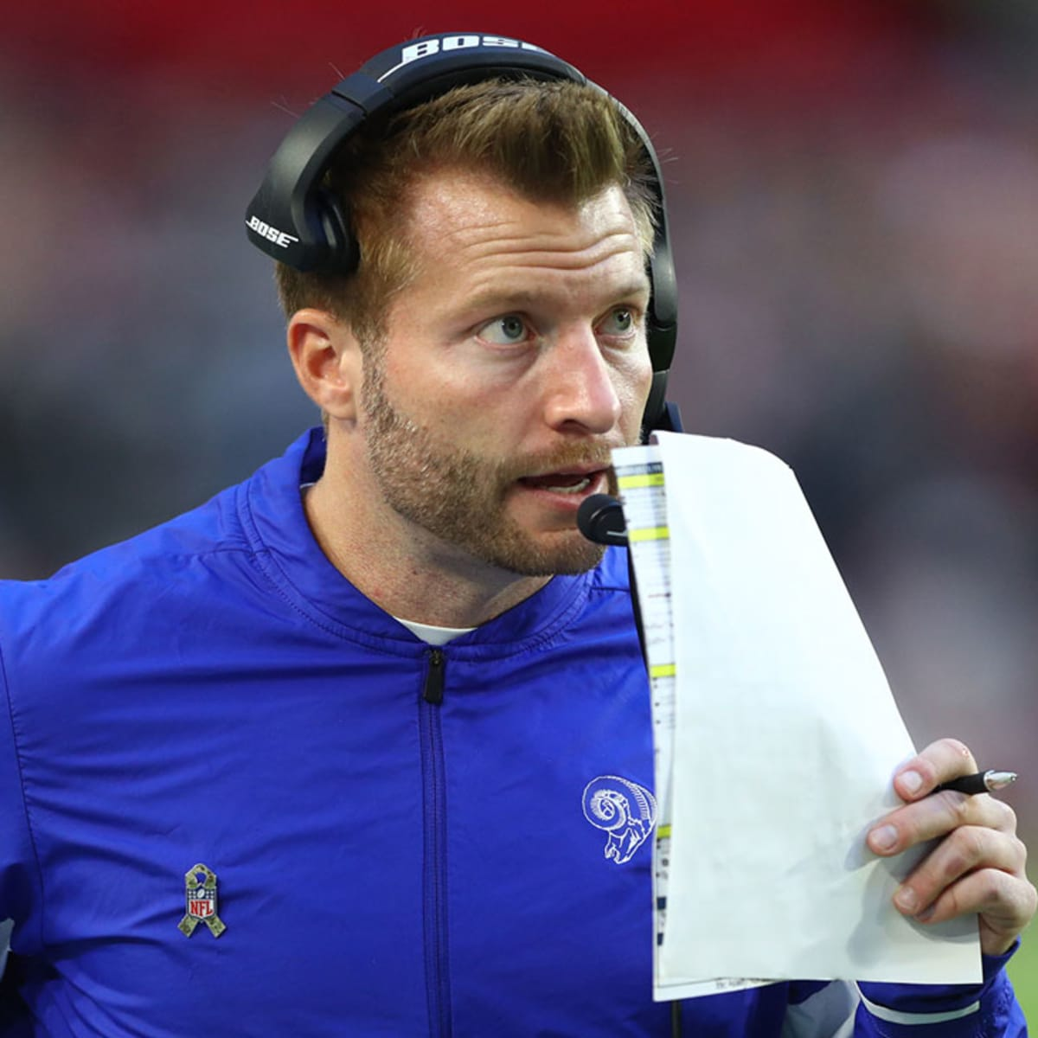
When writing about Sean McVay's offense for the Undefeated,¹ Dominique Foxworth said, "Genius is creativity and ingenuity. In football, it is exploiting an advantage that other teams have yet to find.“
But McVay hasn’t invented a whole new route tree. Foxworth notes that the "core of their passing game" relies on "traditional route combinations.“
Football, then, isn't always about reinventing the wheel (pun intended), but finding which wheels work best to exploit each coverage, and using those tools to put your players into advantageous positions.
1. https://theundefeated.com/features/rams-coach-sean-mcvay-is-an-offensive-genius/

Slide 3
Defining Route Combinations
First, take a holistic look at play calling to find which combinations of routes were called the most frequently.
Include tight ends, wide receivers, slot receivers, and backs split out wide.
Exclude backs coming out of the backfield because:
When they aren't used as decoys, they tend to run flats and swing routes.
Including back routes restricts the number of full route combinations, thereby limiting sample size.
Passes to backs are lower value, and tend to be used as safety valves when not in the screen game.

Slide 4
Other Assumptions
Filtered out all pass plays where the person throwing the ball was not listed as a quarterback.
Filtered out passes where the coverage was unknown, "Other," "Screen," or "Spike," as I felt these weren't useful for analyzing the route combinations or their performance.
Included plays in which the quarterback dropped back but a pass was not attempted as long as the routes and coverage scheme were known.
Effectively assumes all sacks or scrambles are forced by coverage, and that quarterbacks are making optimal decisions about which routes to target.
I acknowledge that this is a rather bold assumption.

Slide 5
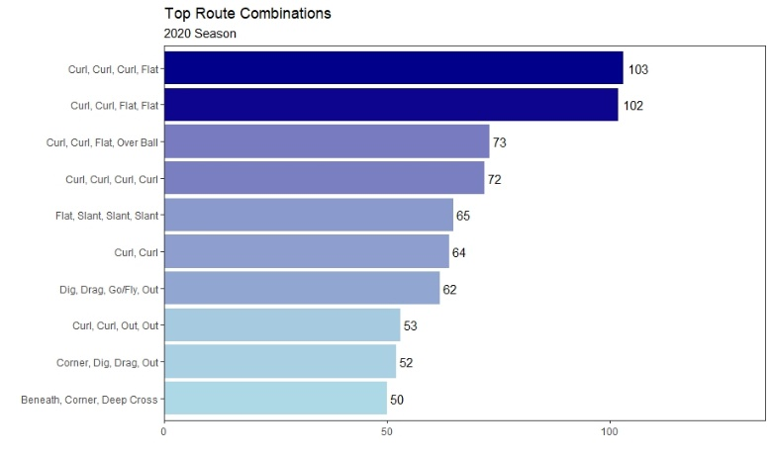
Notes
Lots of curls, which is unsurprising given overall makeup of data set.
Also unsurprising given context of passing in the NFL. Teams pass far more frequently on third and fourth down, and curl routes represent the simplest means of converting in these situations (i.e. run to the sticks and turn around).

Slide 6
Determining Metrics
For the evaluation metrics, I selected two of the more popular advanced metrics: expected points added (EPA), and completion percentage over expectation (CPOE), both of which I've taken from nflfastR.
However, I have opted not to use raw EPA and CPOE numbers.
CPOE is heavily influenced by the quality and skill of the passers making each pass, and I don't want to favor pass routes which were thrown by better quarterbacks.
Same issues using EPA. For example, if a receiver makes a catch and then fumbles, the resulting EPA is negative in spite of the fact that the combination worked.
On the other hand, if a receiver makes a brilliant catch or makes a defender miss in the open field, we are then assigning positive value to a play which isn't inherently due to the route combination, but is rather a function of the players running the route.
Solution:
For EPA, I used nflfastR's air EPA plus xyac (expected yards after catch) EPA. This is then multiplied by the expected completion percentage from nflfastR's model.
Result is an “expected EPA,” or what might be better thought of as mean EPA: the average outcome of a route combination if it were thrown by an average passer to an average receiver.
For plays in which there was no pass, the EPA is set to 0.
For CPOE, I used a composite passer baseline based on the average ability of passers making the throws. This is effectively a weighted average CPOE by passer for each pass in our top combination metric, which is then compared to the route combination CPOE to get an adjusted metric.
Passer CPOE based on prior three seasons (2018-20)

Slide 7
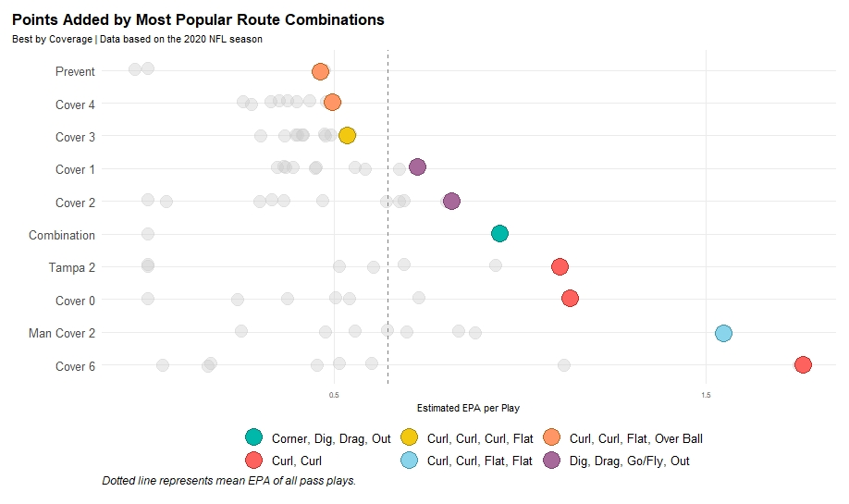

Slide 8
Summary of EPA results
Curl, Curl, Flat, Over Ball: Most effective combination against Prevent and Cover 4
Curl, Curl, Curl, Flat: Most effective combination against Cover 3
Dig, Drag, Go/Fly, Out: Most effective combination against Cover 1 and Cover 2
Corner, Dig, Drag, Out: Most effective combination against Combination coverage
Curl, Curl, Flat, Flat: Most effective combination against Man Cover 2
Curl, Curl: Most effective combination against Tampa 2, Cover 0, and Cover 6

Slide 9
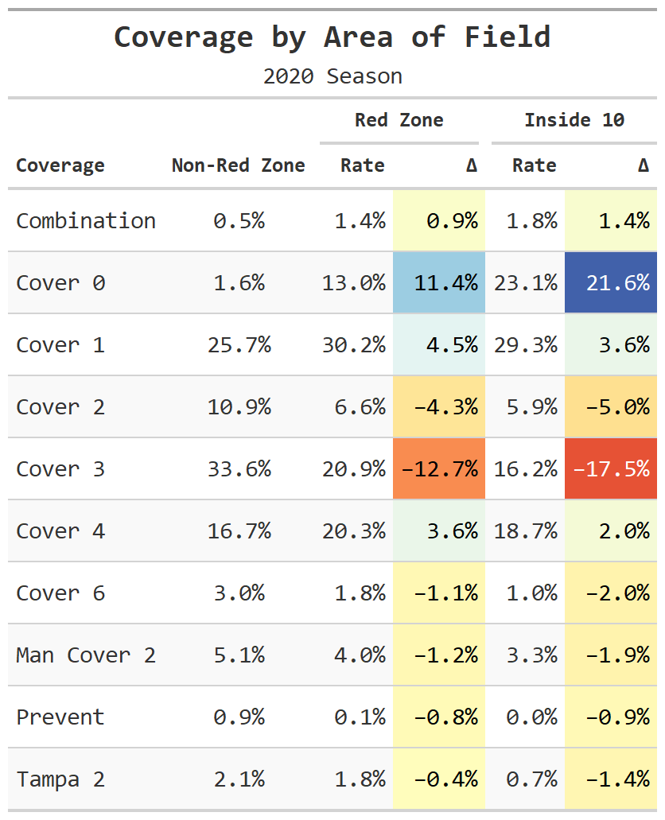
Summary, Cont’d.
Worth noting that teams change their coverage schemes based on area of the field. When the ball is outside the red zone, teams rely heavily on Cover 3 (33.6%), Cover 1 (25.7%), and Cover 4 (16.7%).
Inside red zone, Cover 0 leaps from 1.6% usage to 13%, while Cover 3 drops to 20.9%.
Inside the ten, Cover 0 leaps to 23.1% usage, while Cover 3 drops to 16.2%.
Doesn't explain why certain combinations are more effective against these coverages, it does explain why Cover 3's overall mean EPA is so much lower than that of Cover 0.²
2. I assume, sight unseen, that 100% of the non-red zone Cover 0 plays were called by Gregg Williams.

Slide 10
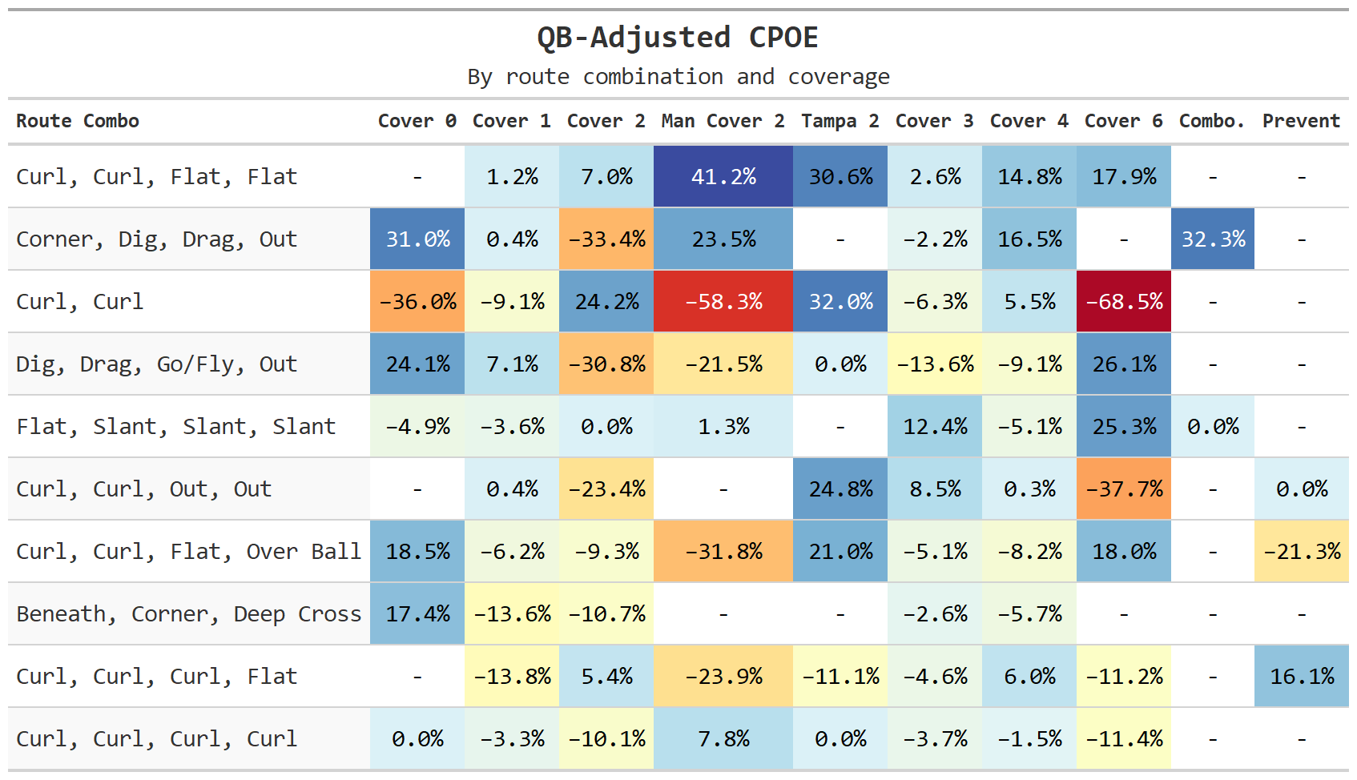

Slide 11
CPOE Notes
Curl, Curl, Flat, Flat was the most efficient route, with a 41.2% adjusted CPOE against Man Cover 2 and no coverages which generated a negative CPOE.
Curl, Curl holds the two least efficient pairings, with a -58.3% against Man Cover 2 and a -68.5% against Cover 6.
Cover 1 and Cover 3, the two most popular coverages outside of the red zone, were the most consistent performers against all route combinations, with very few positive CPOE against numbers.
Cover 2 and Cover 4 were more high variance coverages by CPOE, with good negative values against certain combinations but also high positive CPOE values against others.

Slide 12
Other Combinations
In addition to holistic approach, may also be instructive to look at things more in isolation.
Can take prior analysis and, rather than restricting plays to full route combinations for all receivers, restrict it to all receivers on a single side of a formation.
Look at how teams attempt to create advantages on one side of the field.
Filter out passes by non-quarterbacks, as well as spikes, screens, and other plays where the coverage was not known, while keeping in all plays in which there was a QB dropback.
Used same unlisting function to create a list of all route combinations for each play, but this time I filtered out all duplicate combinations for each play
I didn't want, for example, a play with three curls being run to count as more than one curl/curl pairing.
Also ignored any single-route plays.

Slide 13
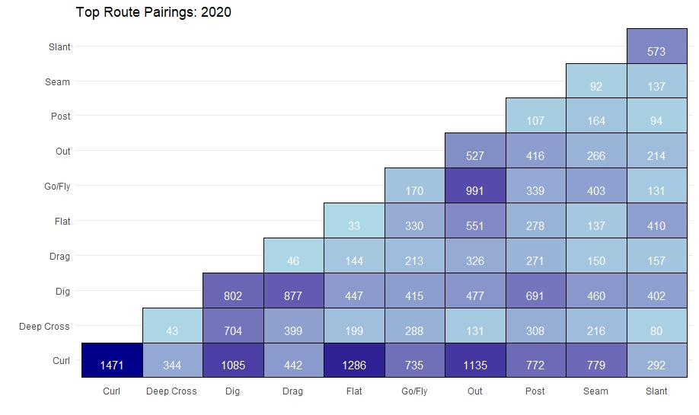
Top Route Pairings
Notes
For simplicity of this graphic, only used top ten most used routes.
Incomplete list, but is instructive in figuring out which routes are paired most frequently.
Curls still most popular route.
Out and dig routes also frequently used in tandem with other routes.

Slide 14
EPA Revisited
Deep Cross, Dig, Drag: Most effective combination against Cover 3, Cover 6, and Tampa 2
Curl, Curl, Fade: Most effective combination against Cover 1
Curl, Curl, Flat: Most effective combination against Cover 2
Curl, Fade, Out: Most effective combination against Cover 0
Go/Fly, Out, Out: Most effective combination against Cover 4 and Man Cover 2
Corner, Curl, Flat: Most effective combination against Combination and Prevent coverages

Slide 15
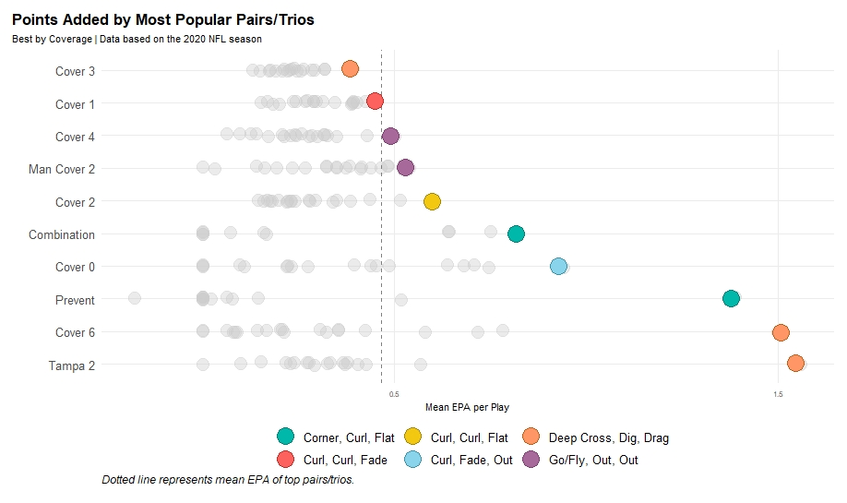

Slide 16
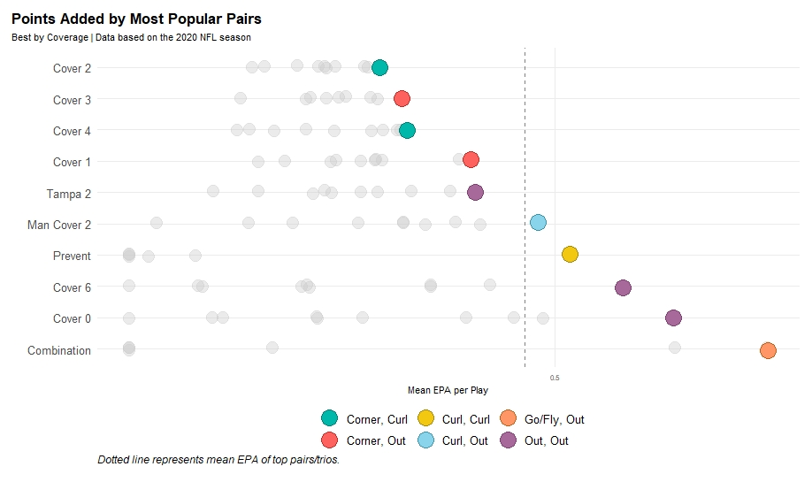
All of the most effective route combinations are trios
Likely due to fact that three routes more likely to draw a target than two routes.
Opted to do same comparison for duos.

Slide 17
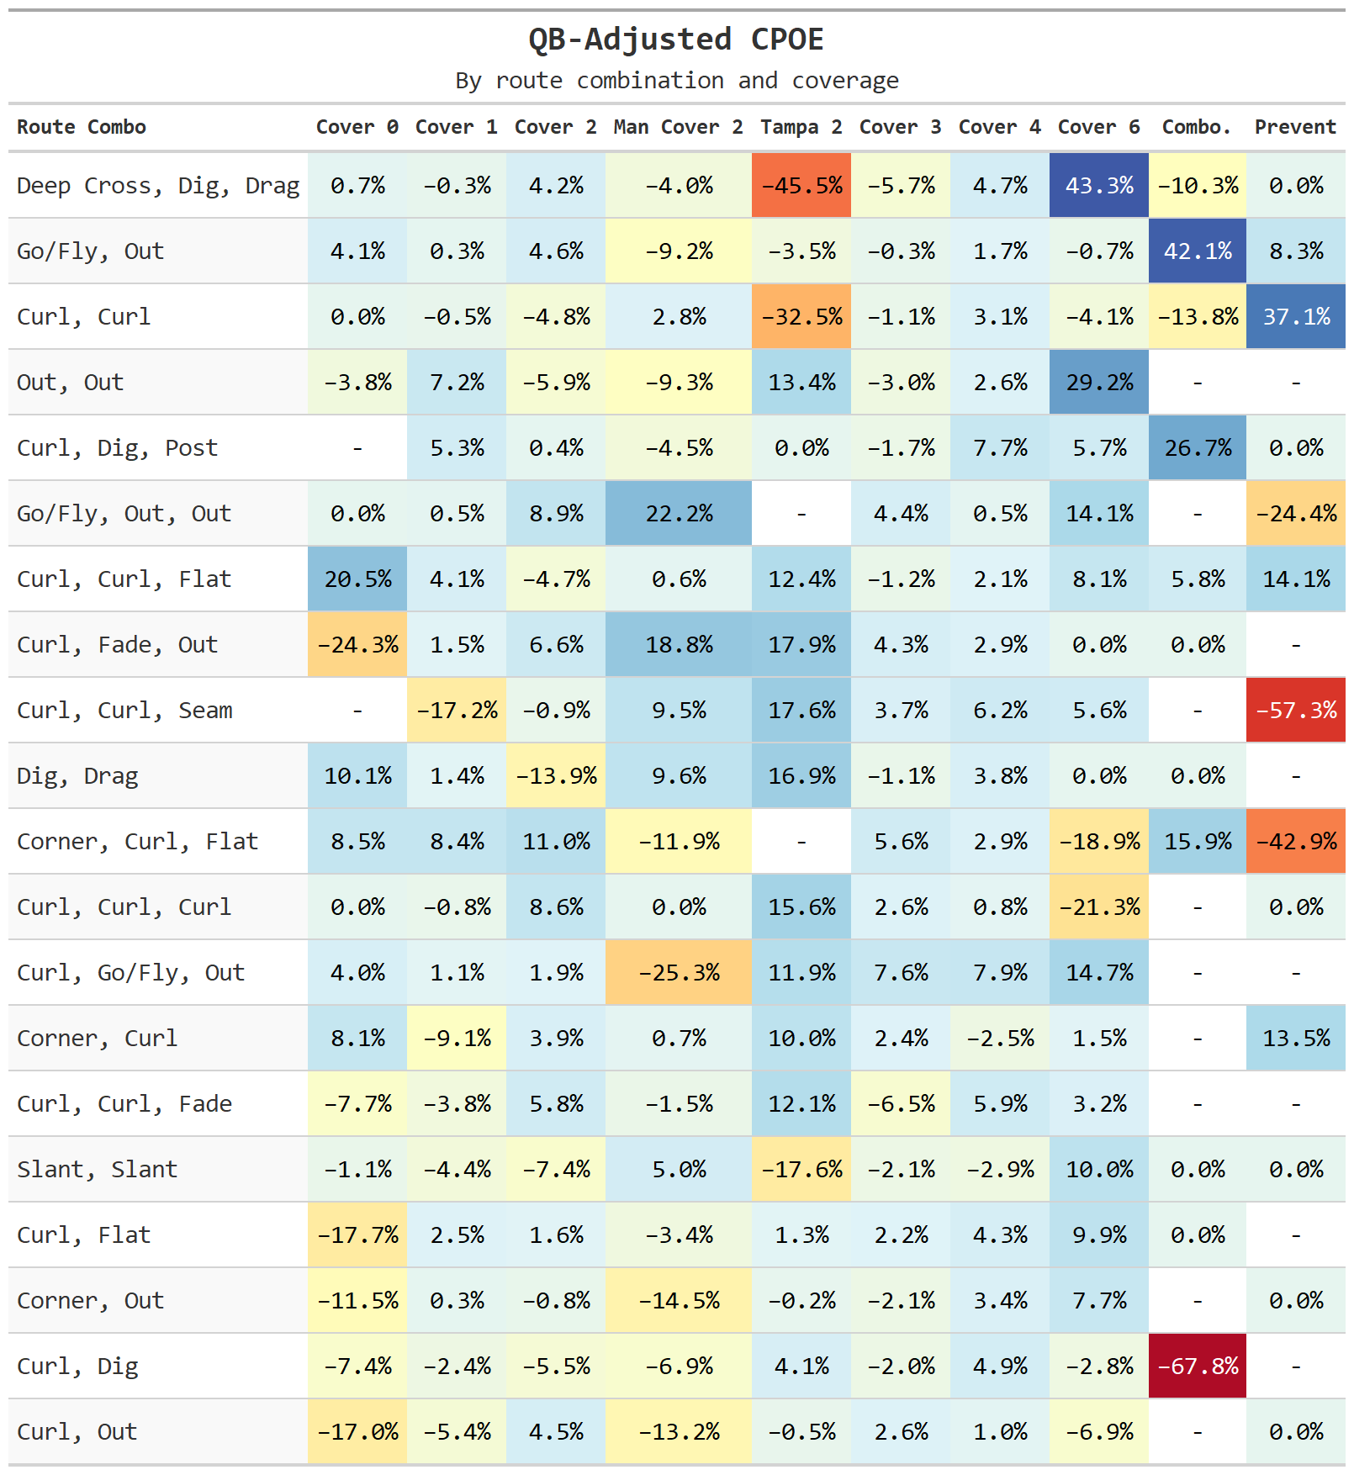
CPOE by Pairs/Trios
Notes
Worth mentioning that once again we see Cover 1 and Cover 3 as the most consistent, least volatile coverages.
We also see that on some plays, the mean EPA rankings and CPOE rankings align (Deep Cross-Dig-Drag vs Cover 6, Curl-Curl vs Prevent), while other times it doesn't (Deep Cross-Dig-Drag vs Tampa 2).
Small sample size in route-coverage match-ups is the most likely culprit.

Slide 18
Assumptions and Future Analysis
Idea that all quarterbacks are acting optimally is the largest, and the most important assumption.
Assumes that quarterbacks target the best, most open route, and that when they opt not to make a pass, it is solely due to coverage.
Not consistent with observed QB play. However, without data on how open receivers are - to say nothing of how a route progression works on a given play - it's impossible to know for certain the true cause of a passer's decisions.
Tracking data could clarify some of the issues involving how well-covered routes are and answer some questions.
Tracking data would also be helpful in providing more accurate QB-adjusted CPOE metrics.
Having a larger data set would also allow better, more accurate conclusions to be drawn. As seen in the variance between EPA and CPOE, small sample size can play a big role in swinging evaluation metrics one way or the other.
Initially filtered out route combination and coverage pairings below a certain threshold, but this left certain coverage schemes out of the results entirely, which I wanted to avoid.
Future Analysis
Adjust for other factors (pressure, motion, play action).
Did not adjust for play action due to lack of information from nflfastR for external items.
Would also like to test a mixed effects model with QB as a variable.

